Slide 1
Critical Design Review
GlidingTeam
Andrew Brown, Connor Crabb-Thompson, Jeremy May, Mark Campbell
Notes:
Jeremy

Slide 2
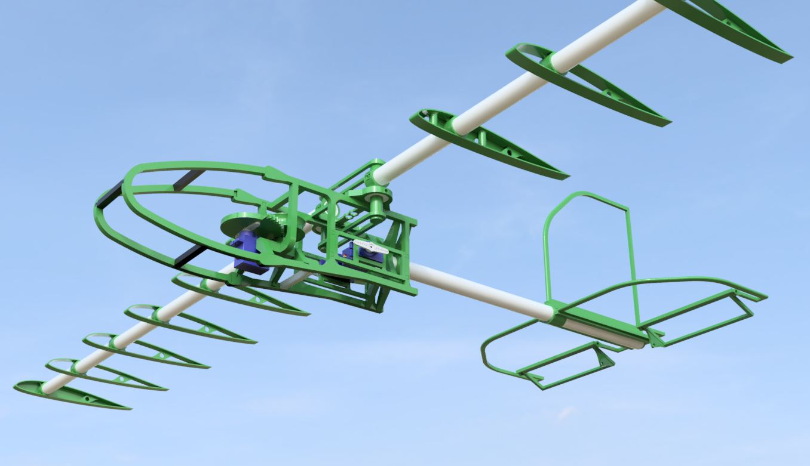
Introduction
Build a glider that can deliver vital supplies to people in need when they are in hard to reach locations
Notes:
Jeremy

Slide 3
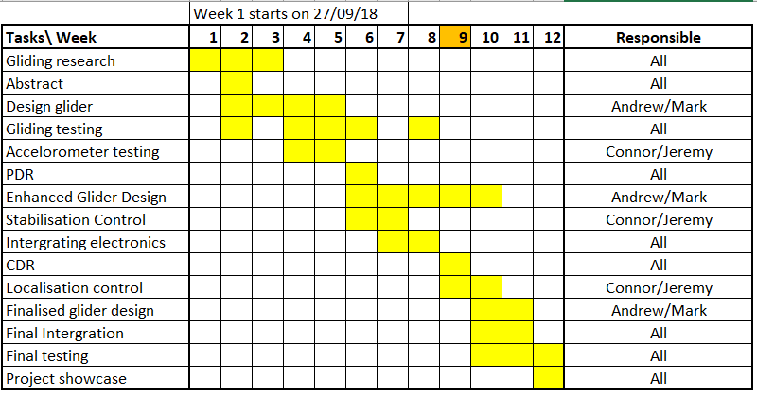
Since the PDR
Glider Testing
Enhanced Glider Design
Stabilisation Control
Integrating Electronics
Notes:
Connor

Slide 4
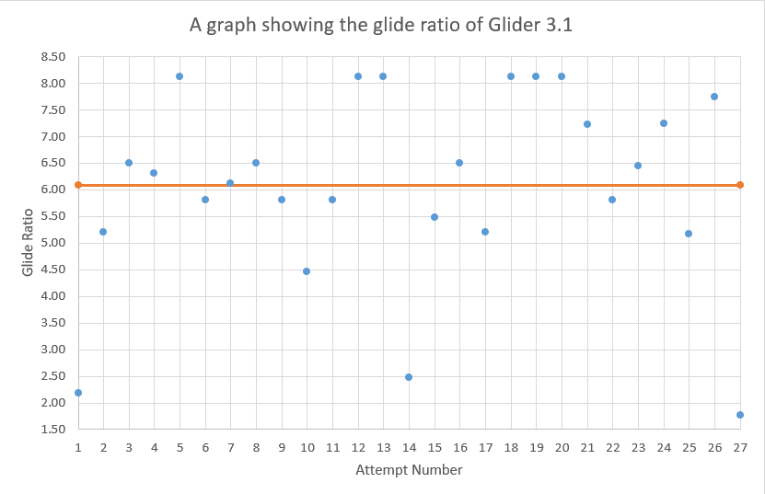
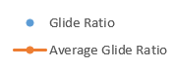
Testing of 3.1
Notes:
6.6 Glide ratio excluding outliers - Andrew

Slide 5
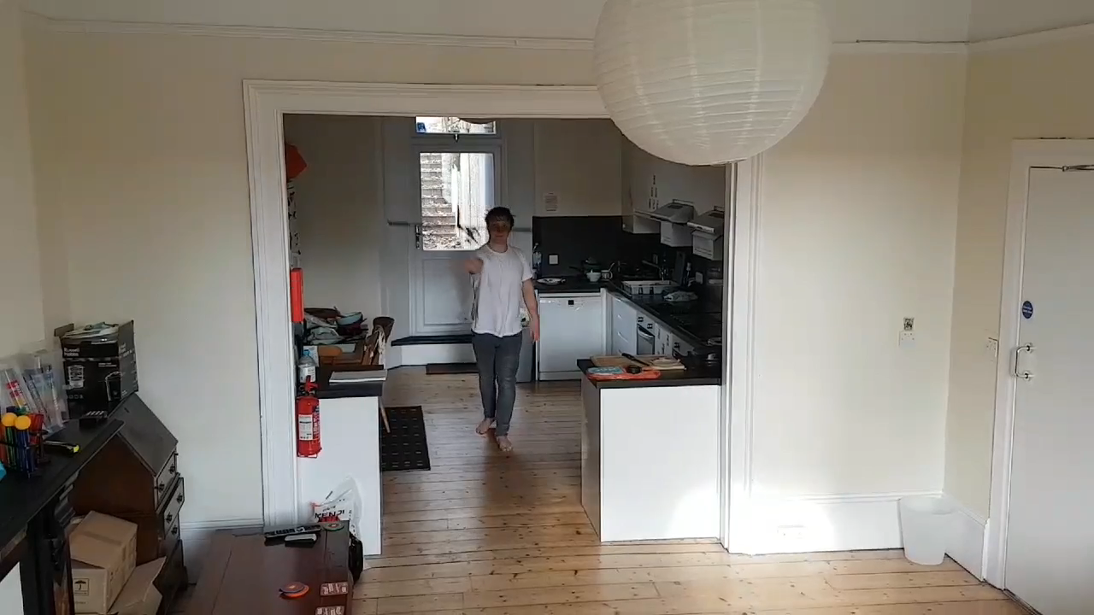
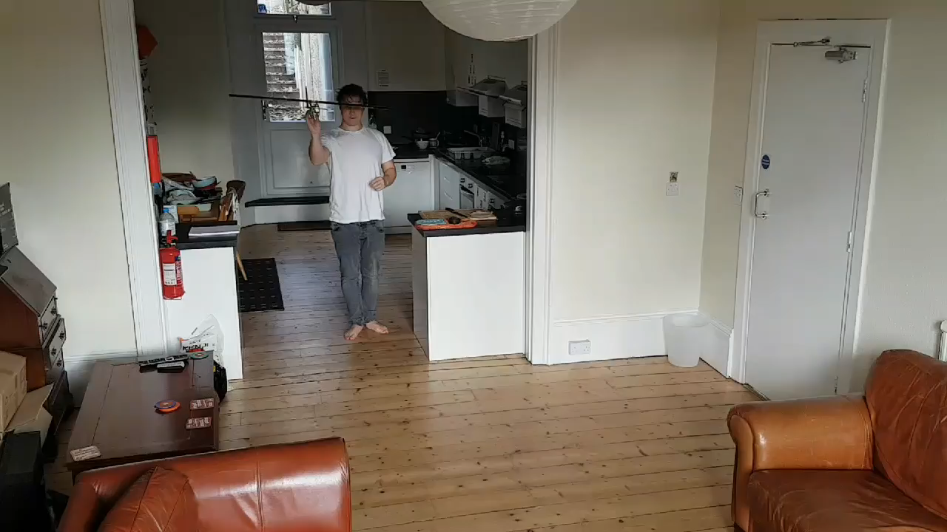
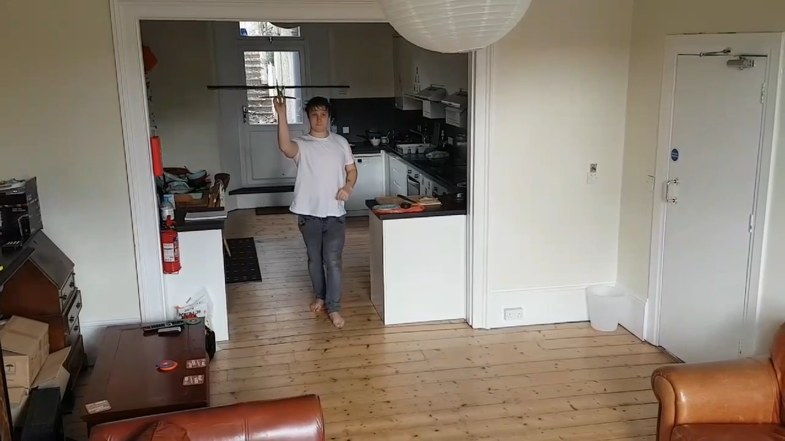
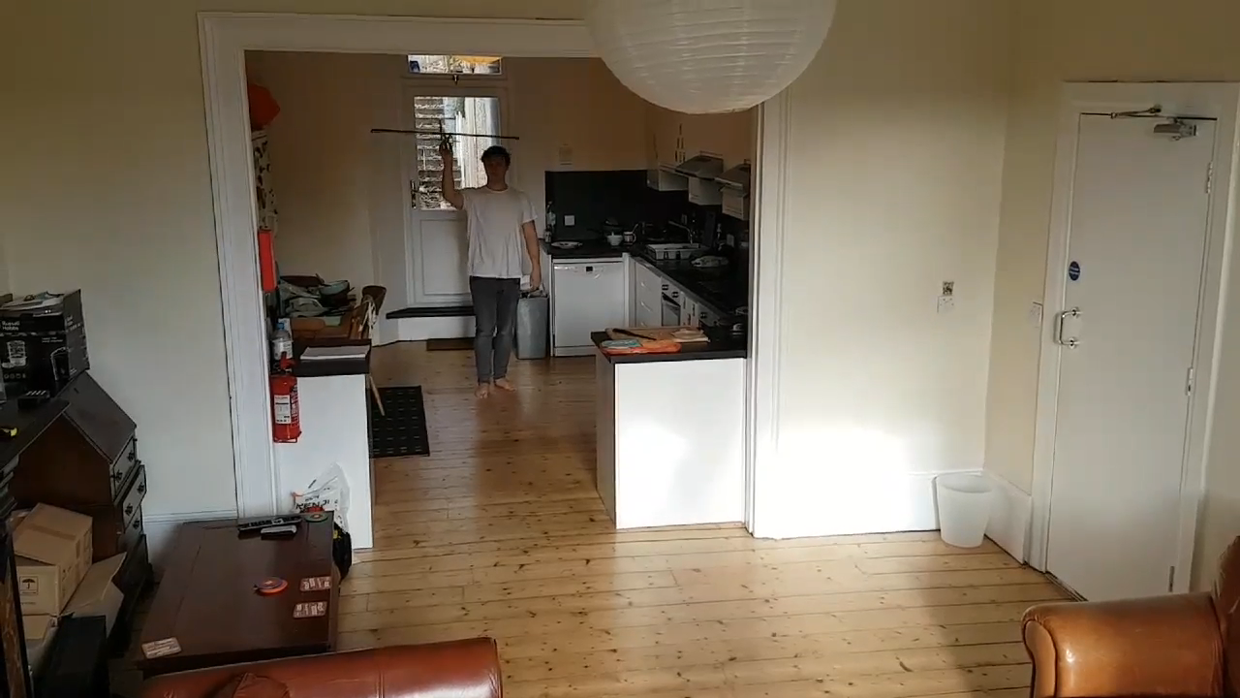
Testing of 3.1

Slide 6
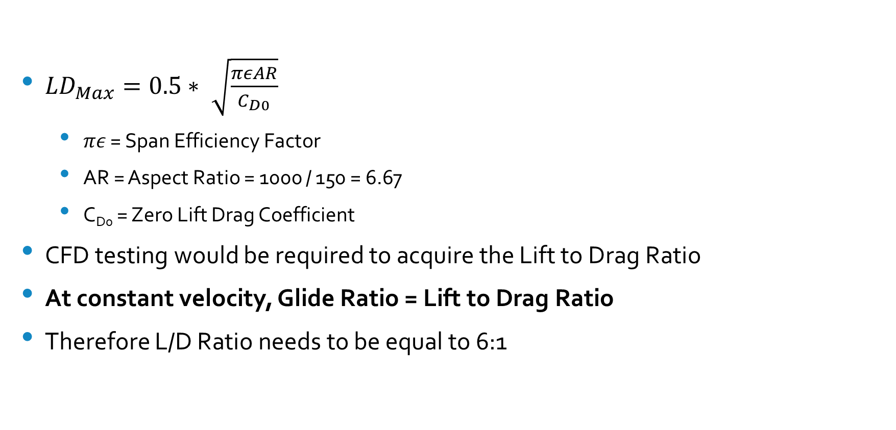
Lift to Drag Ratio
${LD}_{Max}=0.5∗ \sqrt{\frac{πεAR}{C_{D0}}}$
$πε$ = Span Efficiency Factor
AR = Aspect Ratio = 1000 / 150 = 6.67
C_{D0} = Zero Lift Drag Coefficient
CFD testing would be required to acquire the Lift to Drag Ratio
At constant velocity, Glide Ratio = Lift to Drag Ratio
Therefore L/D Ratio needs to be equal to 6:1
Notes:
Jeremy

Slide 7
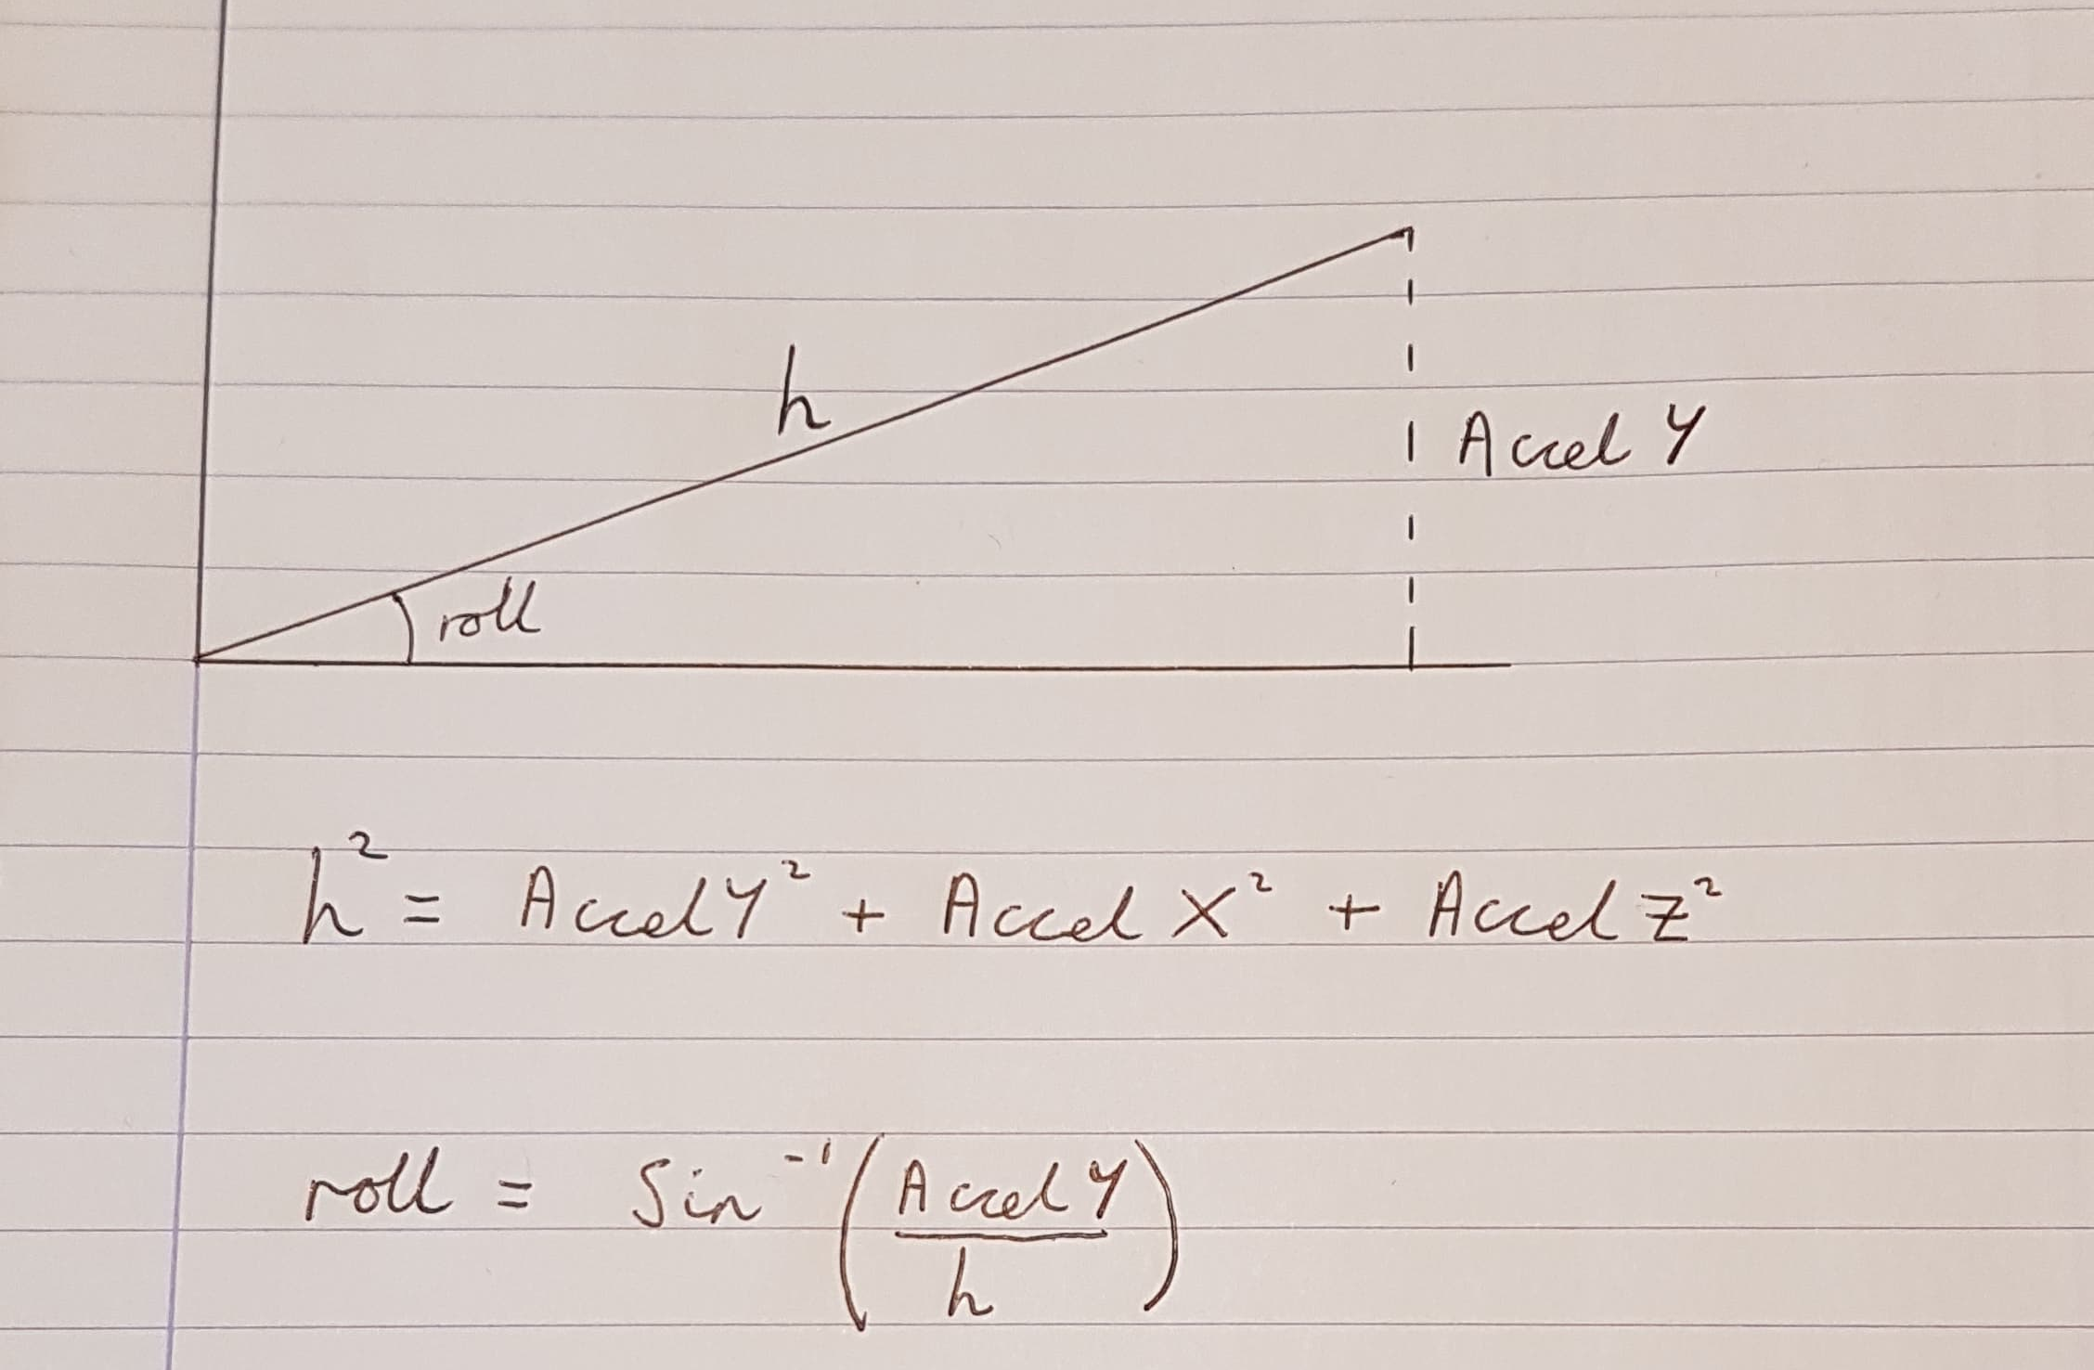
Stabilisation Control
Accelerometer Control
Measure rotation angle with respect to Gravity
If there is acceleration in another direction, rotation angle will be affected by this.
Notes:
Jeremy

Slide 8
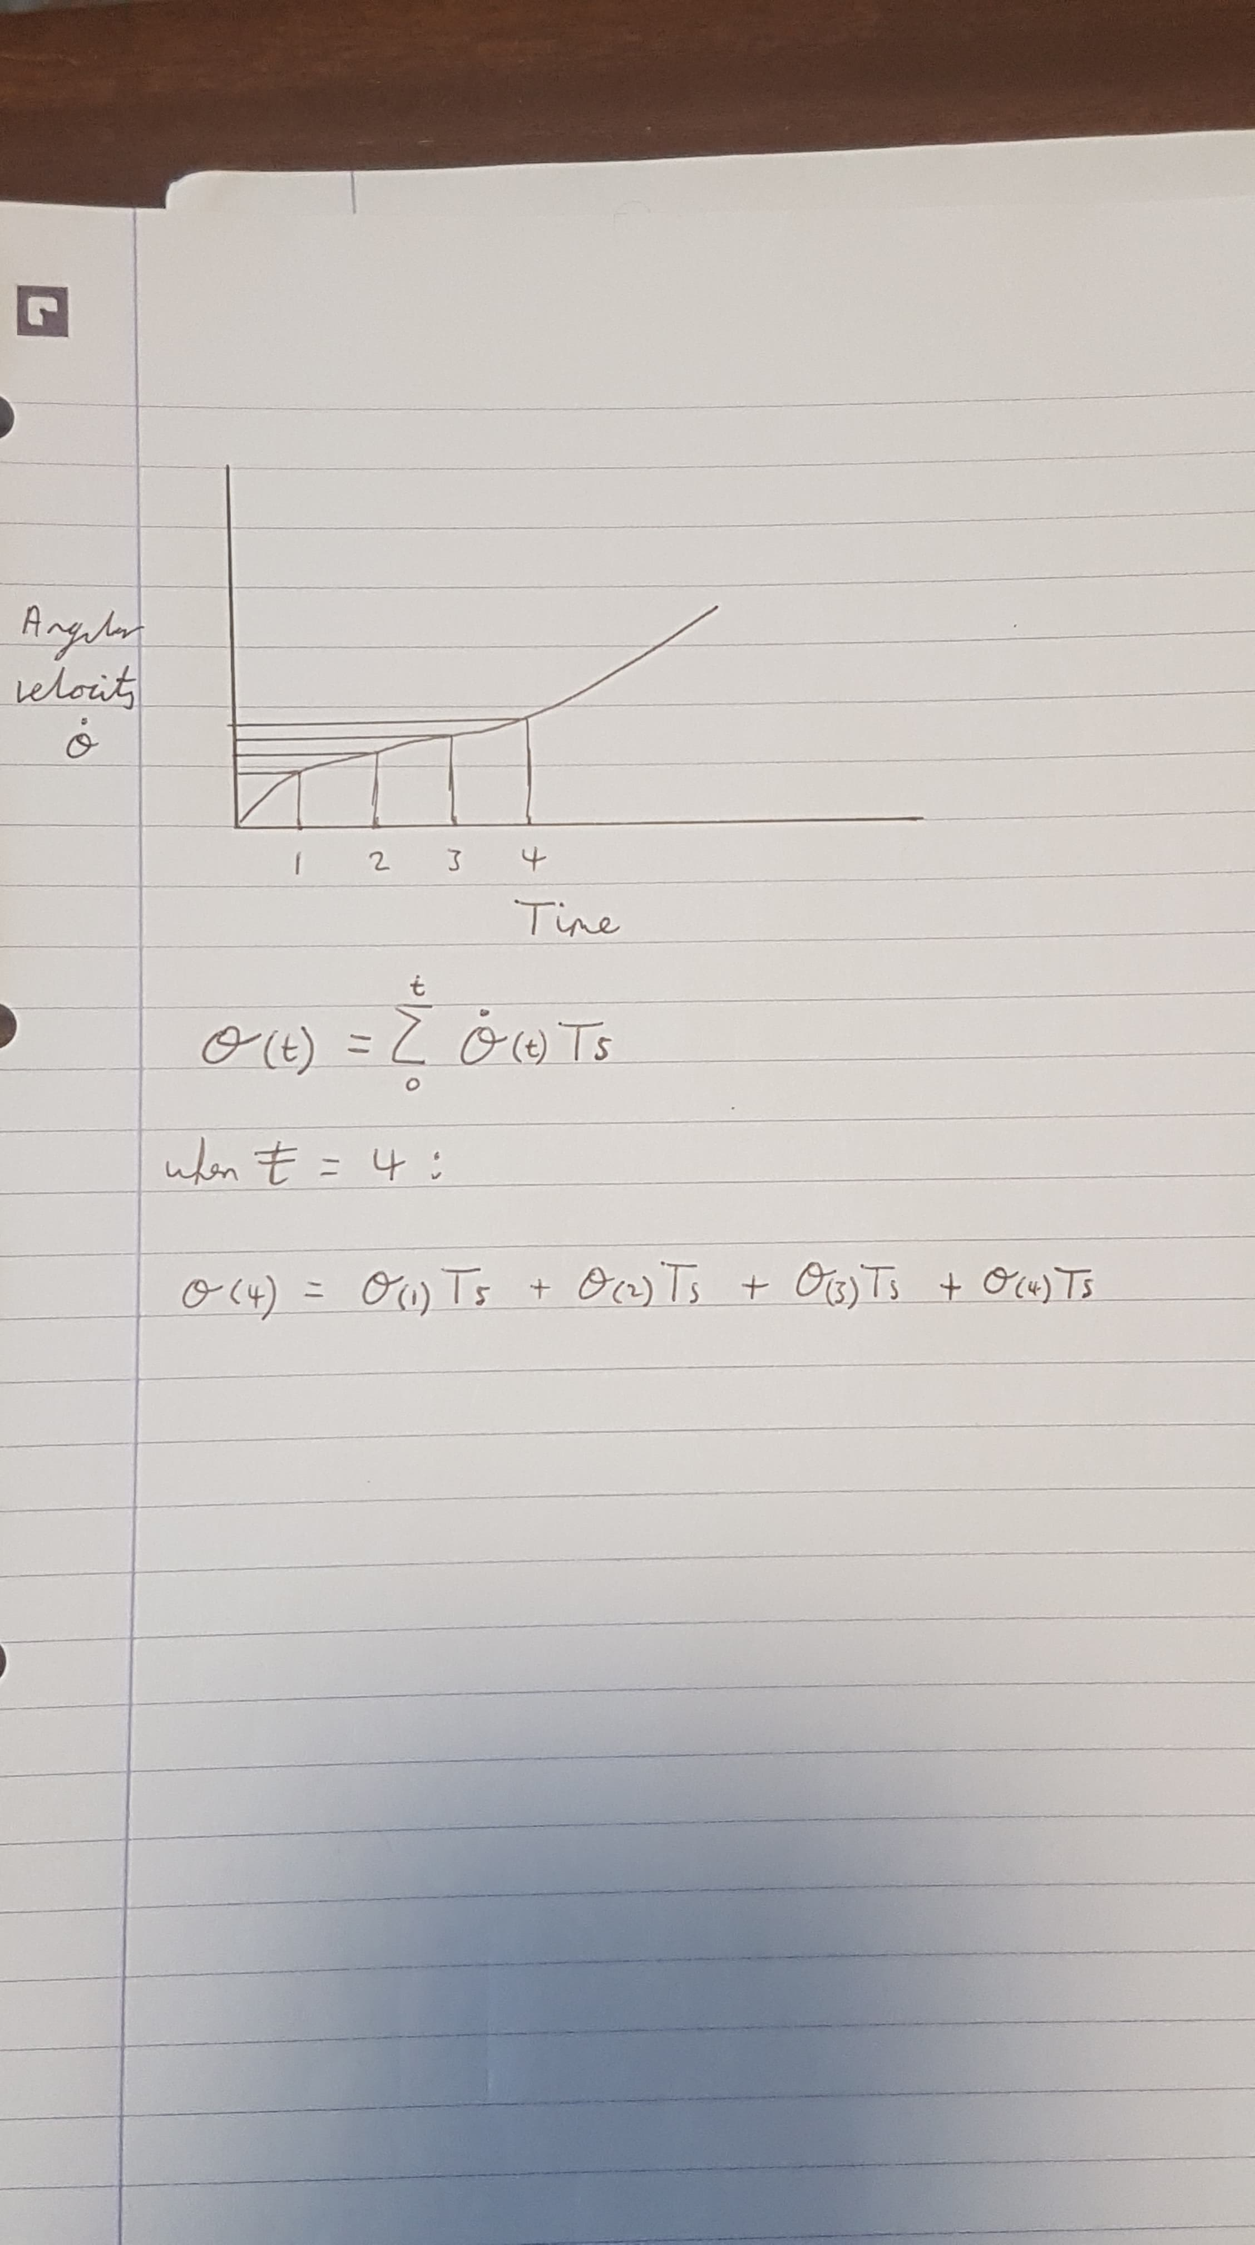
Stabilisation Control
Gyroscope Control
Measure Angle of rotation from angular velocity.
Angular Displacement = $\int_{0}^{t}{Angular Velocity dt }≈$ $\sum_{0}^{t}{Angular Velocity ∗Ts}$
Angle calculations are with respect to the prior value.
Not a continuous integral allowing drift to occur. Minimised with high frequency.
Notes:
Jeremy

Slide 9
Complimentary Filter
Remove the affect of drift by using a complimentary filter with the Accelerometer data.
$$\left(Gyro Angle ∗0.98\right)+\left(Accelerometer Angle ∗0.02\right)=Rotation Angle$$

Slide 10
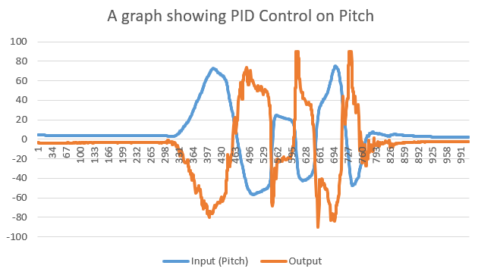
PID Control
Feed Rotation angle as input into PID Controller.
Output used to control servo position.
Steering is achieved by changing the required angle for the PID.
Controller does not currently use Integral due to the drift caused by it.
Further tuning will follow in final testing phase.

Slide 11
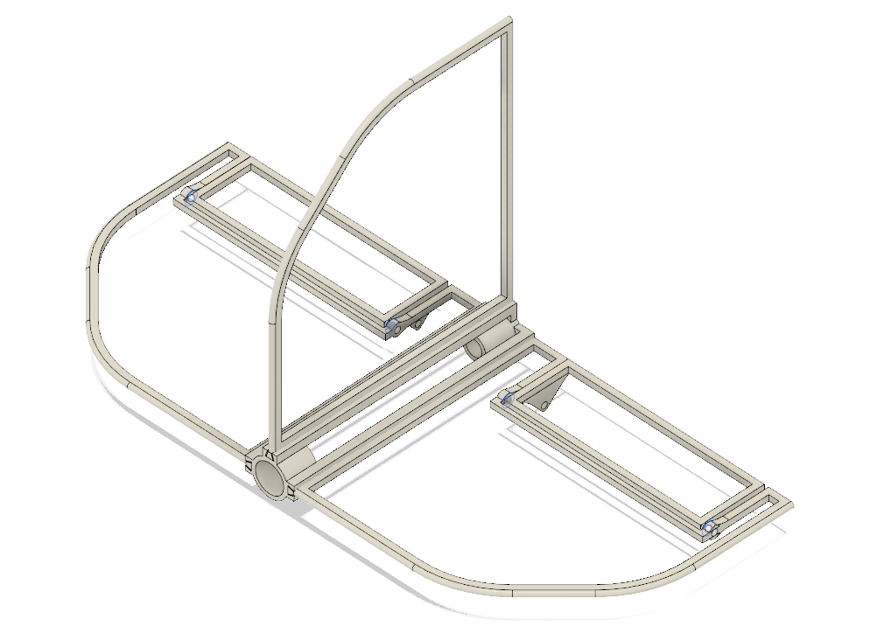
Servo Control
Feed PID data from Pitch and Yaw into each servo using complimentary filter:
$$LeftServo=\left(RollPIDVal ∗0.5\right)+ \left(PitchPIDVal ∗0.5\right)+90$$
$$RightServo=\left(RollPIDVal ∗0.5\right)− \left(PitchPIDVal ∗0.5\right)+90$$
Notes:
Jeremy

Slide 12
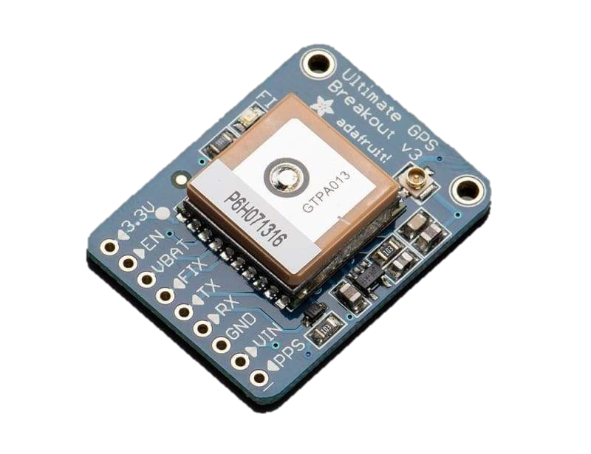
Initial GPS progress
Successful communication with GPS Module
Unable to get GPS Fix
Potentially purchase the optional antenna to go with it.
Notes:
Connor

Slide 13
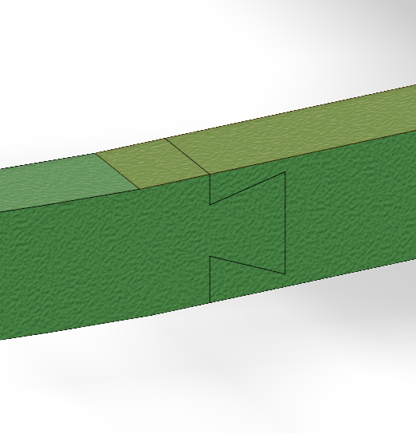
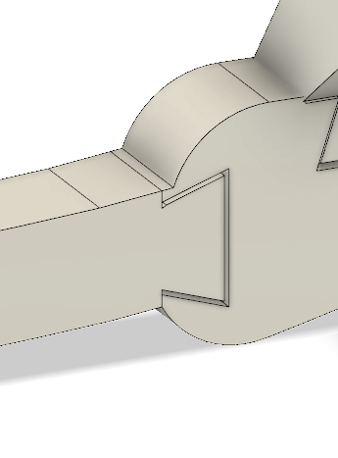
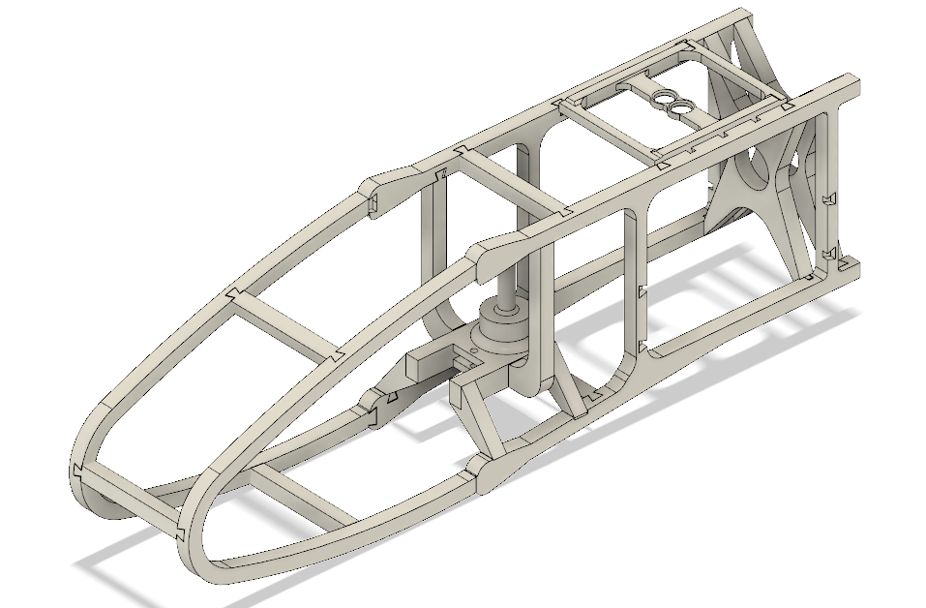
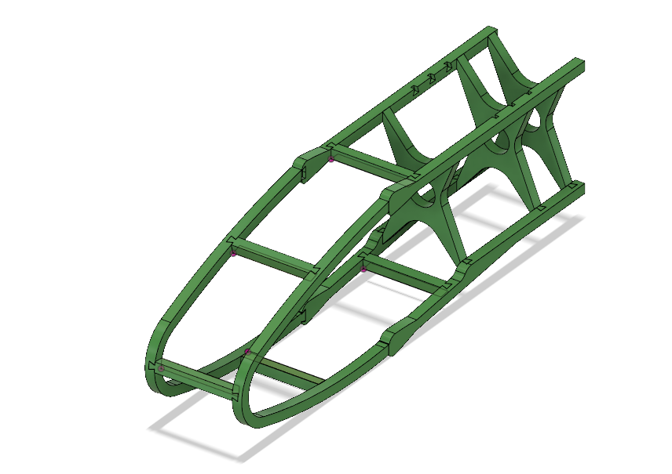
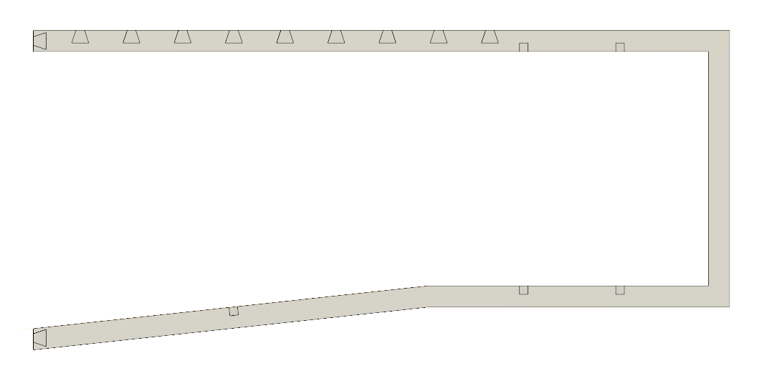
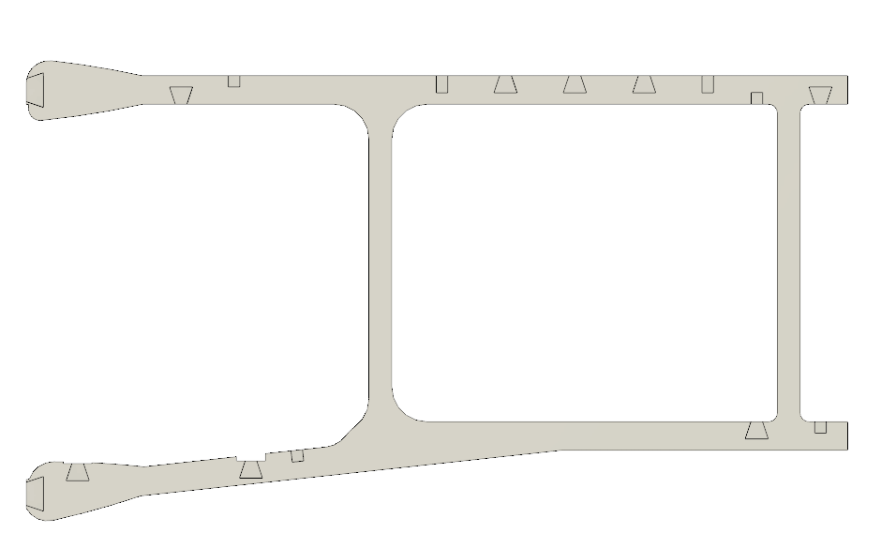
Mechanical Improvements
The mechanical skeleton of the glider was changed to ensure a more rigid body. Locations such as connections where enforced along with adding more optimized struts to reduce weight and increase rigidity.
Notes:
Andrew

Slide 14
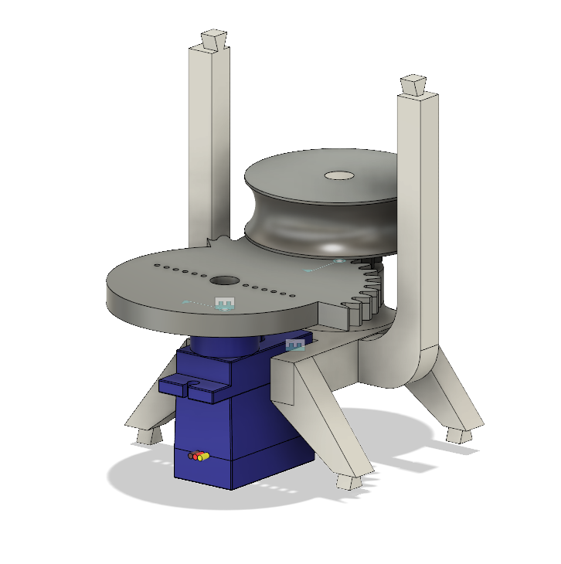
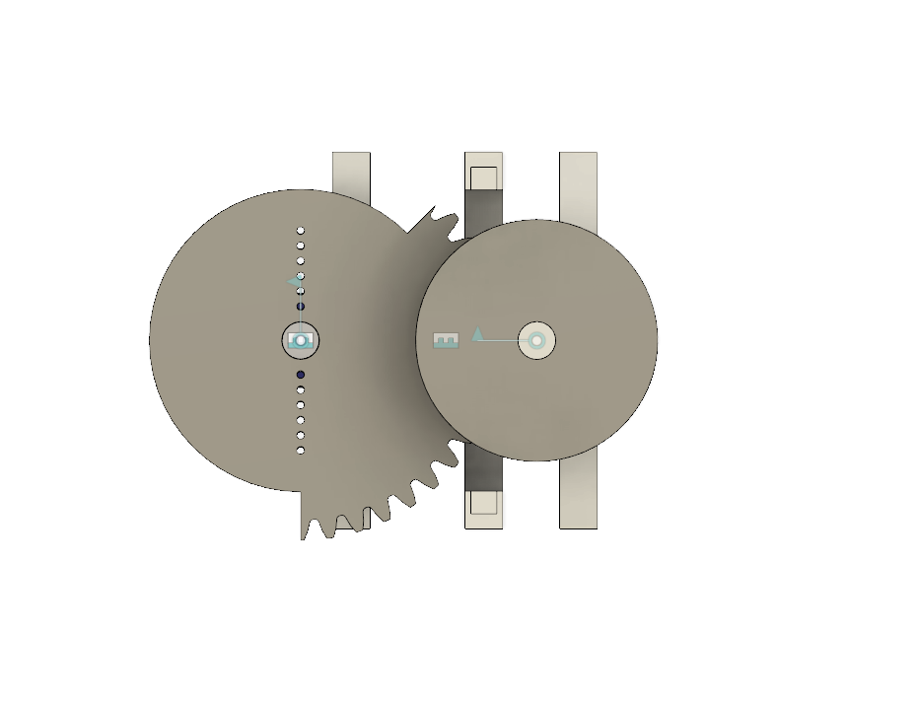
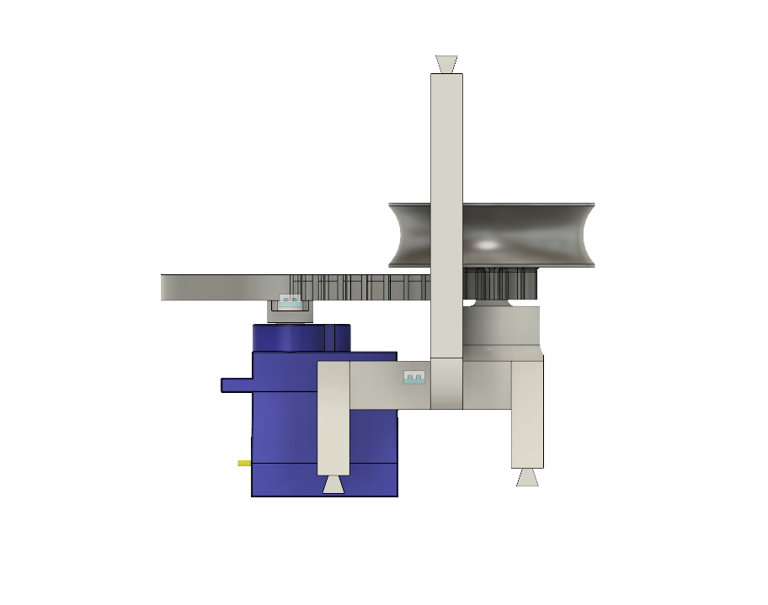
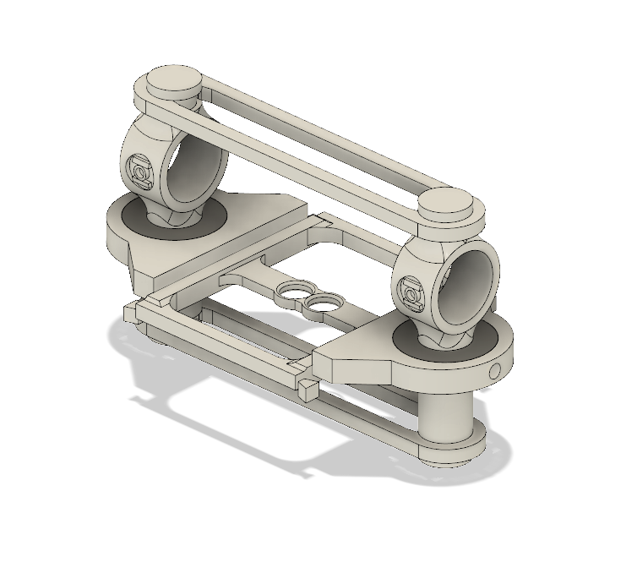
Wing release mechanisum
Retraction and release mechanism.
Wing Mount and Pivot point
Using light weight bearings made of plastic.
Bands used to counter leaver the wings and reduce moments on the bearing.
3D printing orientation was key
Calculations:
Teeth of driving gear : 42 Teeth of driven gear : 10
Gear ratio ~ 0.24 (drive side)
Rotation of drive gear 135 Deg therefore rotation of second gear = 562.5 Deg.
Circumference of spindle average : 93mm
Length coiled = 93 * (562.5/360)
= 145.3125mm
Length needed 141.37mm (calculated from wing rotation)
Notes:
Andrew/Mark

Slide 15
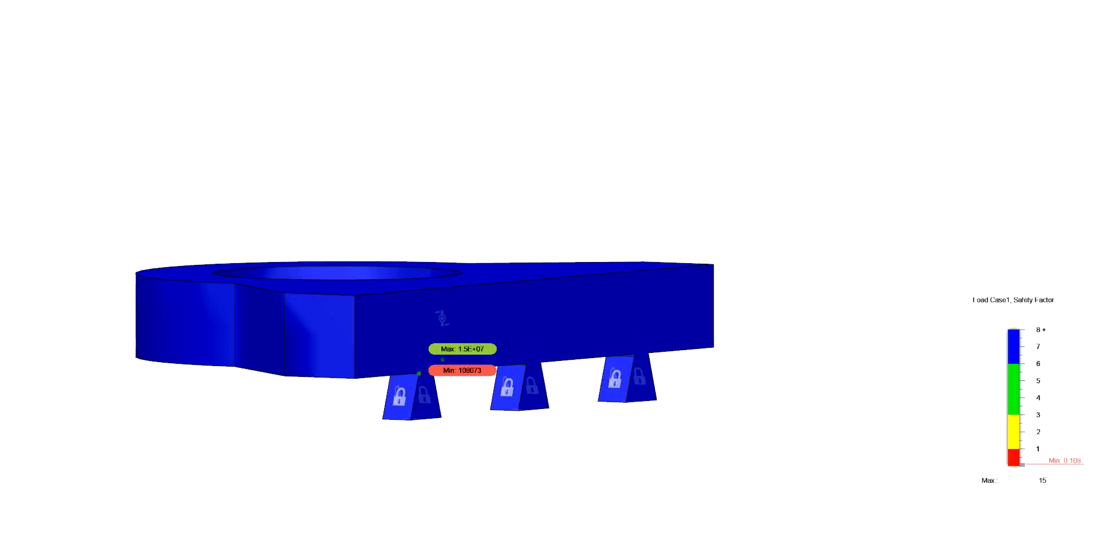
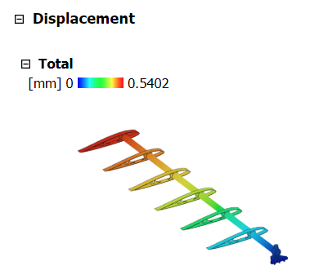
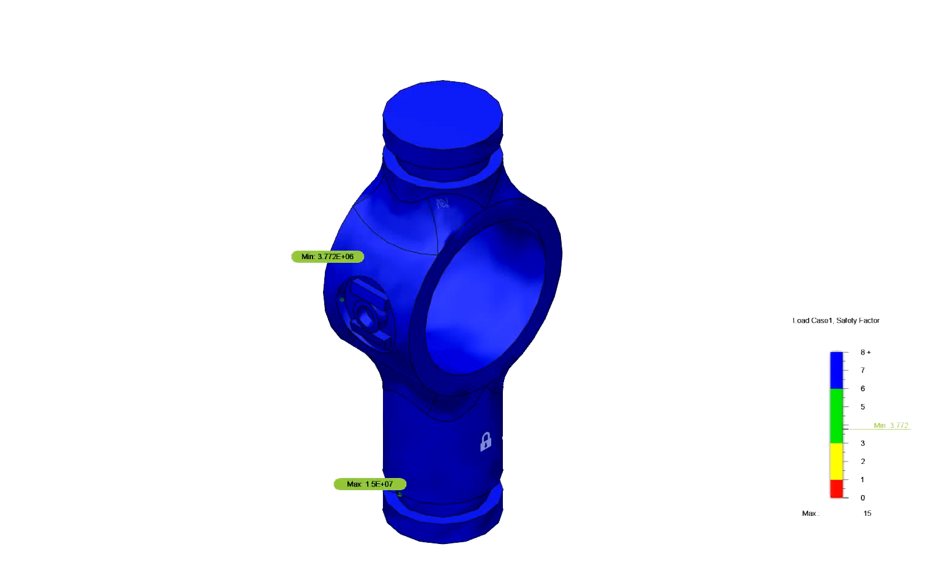
Finite element analysis
Some Initial finit element anaysis has been done to pinpoint strains in the system along with wing displacment. These week points have been reinforced.
Notes:
Mark

Slide 16
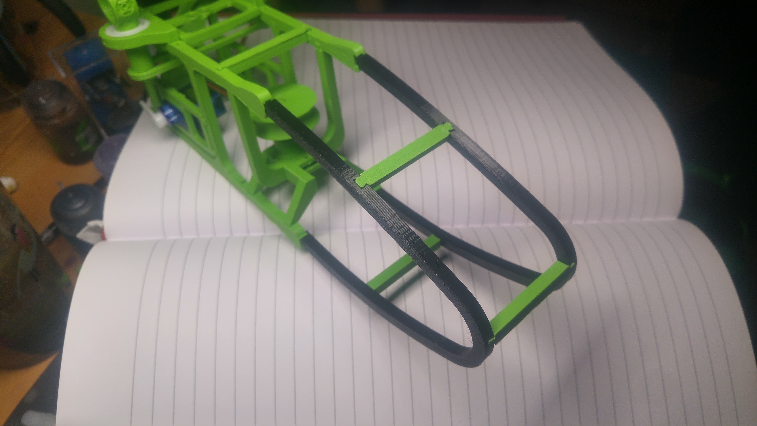
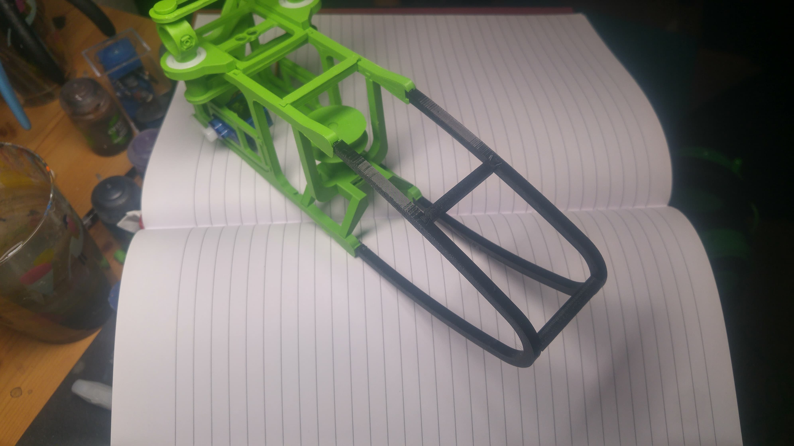
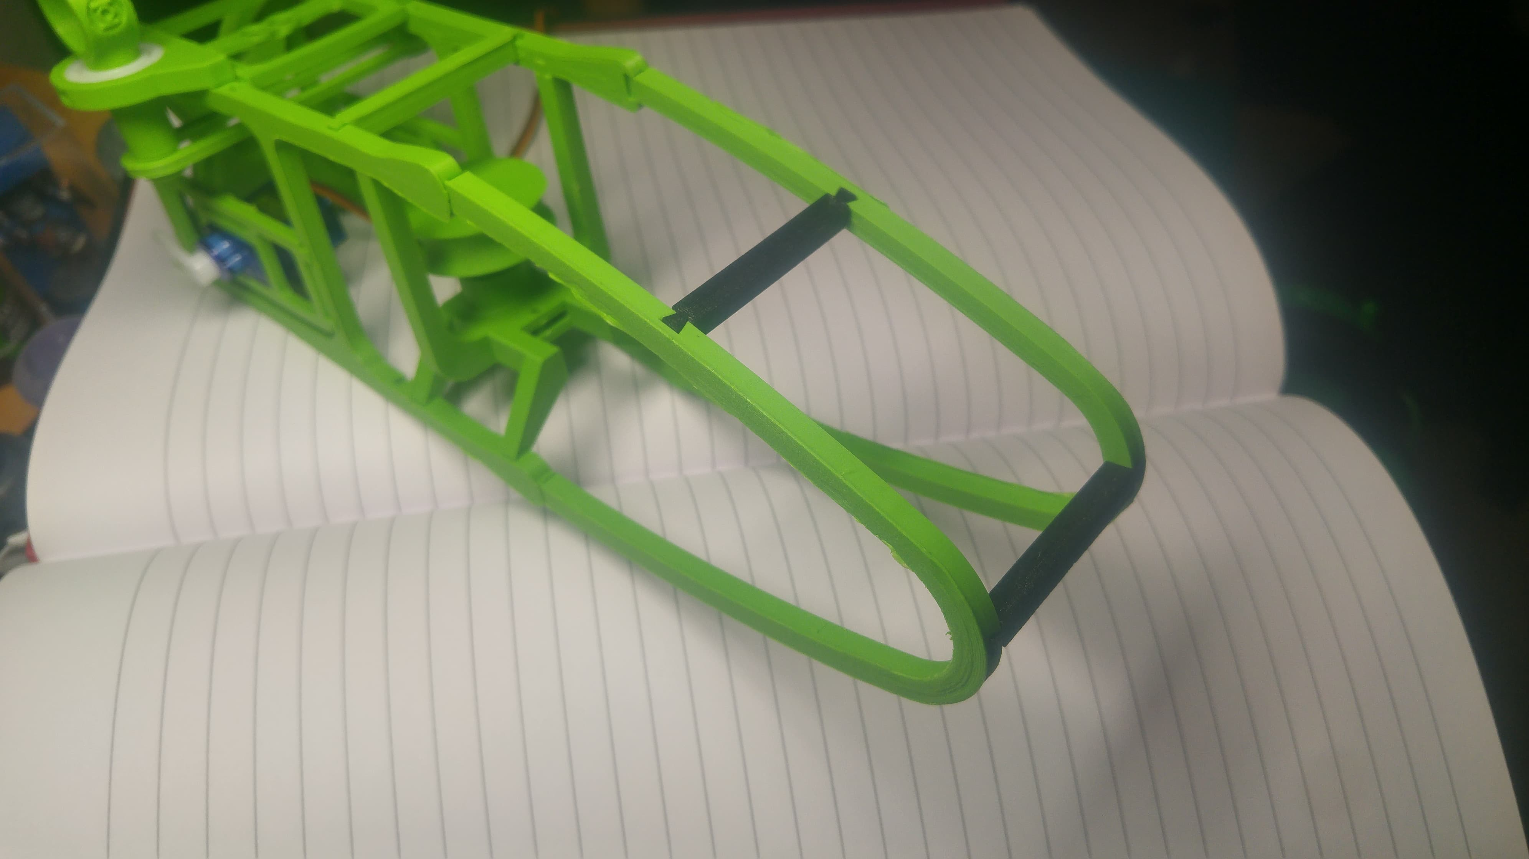
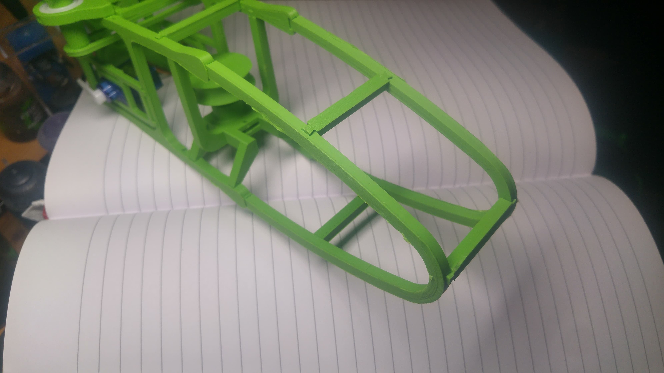
Compliant nose.
Testing done with different combinations of materials.
The best results found with ninja flex struts on the PLA skeleton giving rigidity in gliding yet compliance when impacting structurs
Notes:
Andrew

Slide 17
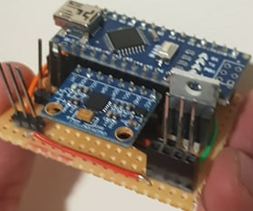
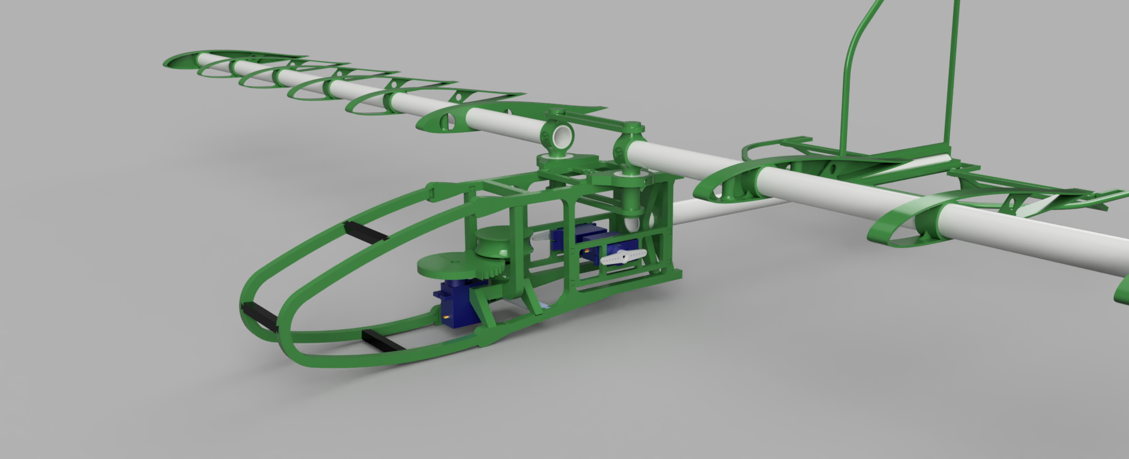
Integrating Electronics
Servo Housing has been built into system
Circuitry has been miniaturised onto Veroboard
Notes:
Connor

Slide 18
Further Development
Test, Test and Test
Wing release mechanism
Servo Control Electronics
Weight Distribution
Structural analysis
Integration Testing
Tensile Hardness Testing
Full System Testing
Controlled environment Testing
Explore elastic for wings
Other Aerodynamic Testing
Tweak where possible, bodge where necessary
Notes:
Connor

Slide 19
Questions?

